Slide 1





Titel Presentatie
Subtitel
Lessons from the API Management trenches
© 2018 Motion10 | motion10.nl

Slide 2



Eldert Grootenboer
@egrootenboer
Notes:
Rustig praten
Intonatie

Slide 3
API Management
Notes:
Customer story, came to use for cloud migration and api strategy, complete application landscape will be changed.

Slide 4
API centric architecture
Connected experiences
APIs
Services and data
Notes:
Exposing processes and data through APIs to the outside world, instead of having everything safely in their own network.

Slide 5

Solving our API strategy challenges
Connected experiences
Abstract
Secure and protect
Manage lifecycle
Monitor and measure
Validation
Discover
Get access
Try
SDKs and samples
Consume
Mediate
Publish
Developer portal
Gateway
Azure portal
APIs
App Developers
(use APIs)
API Publishers
(provide APIs)
Services and data
Notes:
Talk about the challenge, and how API Management solves each of these.
Rustig praten
Intonatie

Slide 6
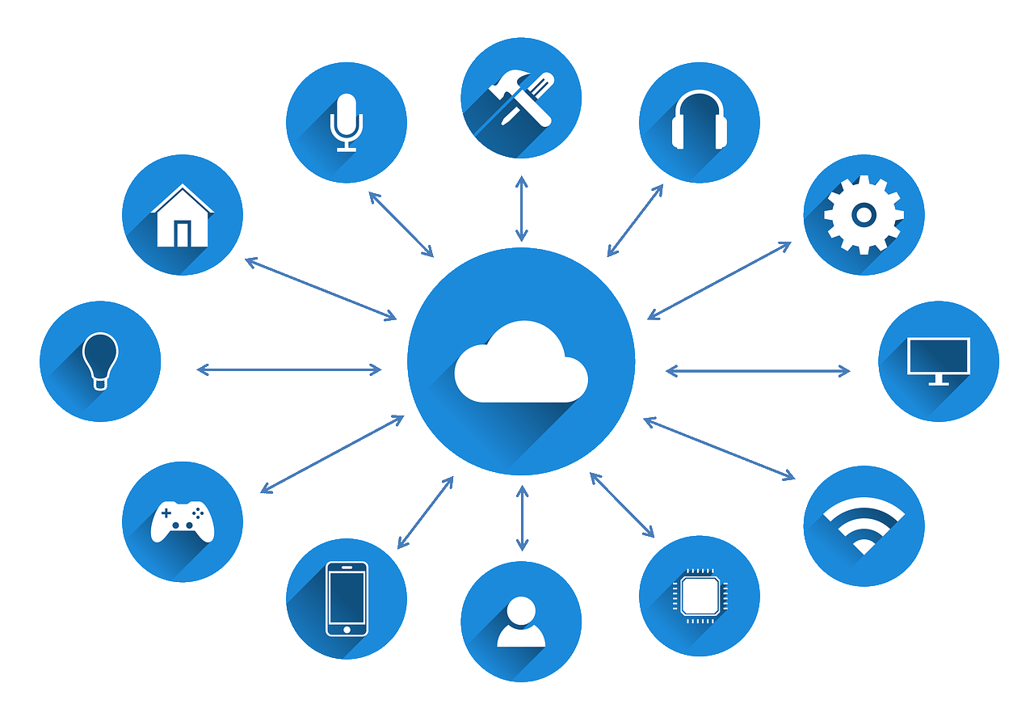


Environment
Instances
Settings
&
Secrets
Access
Management
Notes:
DEMO on how to create users, groups, products and subscriptions (for users and services).
Explain how we have come from 2 tiers, expensive and very expensive, to 5 tiers these days, and when to use which, and why de Goudse selected Premium.
Settings (like retry intervals) can be stored in Named values, but not secrets (like passwords), these we store in Key Vault, talk about how you explained this to a developer.
Rustig praten
Intonatie

Slide 7



Hybrid
VNET
IP Whitelisting
Self-hosted
Gateway
Notes:
VNET allows us to make API Management part of our internal network.
If Premium is too expensive, we can use IP whitelisting instead.
Now also the option to use the federated gateway, announced at Ignite, uses Azure Arc, provides a docker container which can run anywhere Kubernetes can run, including on your toaster.
Rustig praten
Intonatie

Slide 8
Policies
Notes:
Talk about ECT and their problem, which is a service for requesting container information which over time was used a lot more by software providers, so they wanted to put some restrictions on this.
Go onto your own experiences from the past with the ECT, when you were still working as a deckhand.
Rustig praten
Intonatie
30

Slide 9


Policies
Chaining
&
Error Handling
Capabilities
&
Restrictions
Scoping
Notes:
Provide capabilities like caching and restrictions like throttling, and how this helped the ECT.
Chaining allows output from one policy to act as input for the next, while error handling helped ECT to hide stack trace messages, but instead give proper clean responses.
On instance level we did error handling, on product level we did caching and throttling, on API level we added authentication headers, and on operation level we did simple message body transformation.
Rustig praten
Intonatie

Slide 10


Policy Expressions
XML
&
C#
Custom
Policies
Notes:
DEMO Show policies in the portal
Basically XML messages with C# expressions in them, many out of the box policies provided, which are added as XML snippets.
Custom policies allow us to create our own policies if those out of the box don’t give all we need, such as routing when a message is too large.
Rustig praten
Intonatie

Slide 11



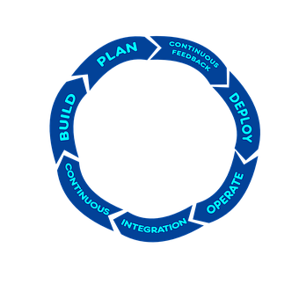
Visual Studio Code
Resource
Explorer
Policy
Editing
Testing
DevOps
Integrated
Notes:
DEMO on all of these, using visual studio, including showing how intellisense works.
Rustig praten
Intonatie

Slide 12


ALM
Production
Development
deploy full or subset of templates on schedule or on request
deploy templates as part of build or manually
API publishers
https://aka.ms/apimdevops
API developers
extract
write
API definition
Service template
Service template
fork
API and operation policies
Master template
API templates
API and its sub-resources
auto or
manual merge
Master template
API templates
API and its sub-resources
pull request
generate template
from development
artifacts
Shared templates
Shared resources
validate
Shared templates
Shared resources
Publisher repository
Developer repository
Notes:
Walk through the different steps taken to fork, create or modify an API, and then merge back.
Extractor & Creator
Rustig praten
Intonatie

Slide 13
Almost done…
Notes:
Rustig praten
Intonatie
40

Slide 14
Recap
Abstract backend services
Transform messages and protocols
Add restrictions or capabilities to your services
Gain insights and provide analytics
Notes:
Rustig praten
Intonatie

Slide 15



Thank You!
@egrootenboer
eldert@eldert.net
https://www.linkedin.com/in/eldert-grootenboer
Notes:
Rustig praten
Intonatie

